Slide 1
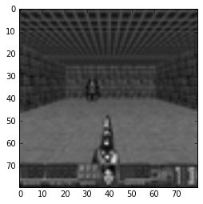
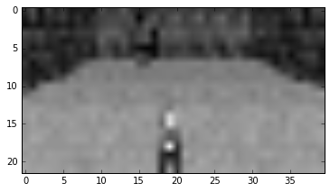
Apprenticeship learning
Idea: If someone play good we can try to predict his next move basing on game“s screens
We played about 400 games in basic doom and gathered about 1GB pictures of states and actions on them
First we tried methods from Sklearn. After picture preprocessing we found out that best classifier is Linear Regression. Result for prediction player“s actions is 0.973 ± 0.005.
But results of the game are really non -robust -13.110 ± 170.719
NN now is learning

Slide 2

Want your ML to play Doom?
Agent whatches human plays
Deep structure
Usual ML expiriment architecture
Do some Reinforcement Learning
Deep structure
Q-learning
E-SARSA
N-steps algorithms
Setup:
Vizdoom[1]\OpenAI.Gym[2] — python doom environment with tones of features
AgentNet – RL wrapper[3]
Theano
Lasange
[1]http://vizdoom.cs.put.edu.pl/
[2]https://gym.openai.com/
[3]https://github.com/yandexdataschool/AgentNet

Slide 3
RL Baseline ~[4]
**DRAW CONV NN OF OUR ARCHITECTURE
1-step Q-learning

